Slide 1
Frame Aligner
Verification plan

Slide 2
Introduction
Design Overview
The frame aligner module monitors an incoming data stream to detect a specific header pattern ( 0xAFAA or 0xBA55).
When it identifies this pattern in three consecutive frames, it confirms alignment.
If four consecutive frames lack the expected header, it signals that the stream is out of alignment.
Goals of Verification
Verify correct detection of header patterns and the alignment process.
Validate the module’s response to misalignment cases.

Slide 3
Simulation Environment
The simulation will be conducted using the SystemVerilog environment, with a testbench specifically
designed to simulate the frame aligner.
The testbench will feed data streams into the frame aligner module to monitor its response to header
patterns and check alignment detection.
Simulation Flow
The simulation will be executed in multiple phases, each covering different test cases.
Each phase will involve sending varied data patterns, including correct and incorrect headers,
to observe the module's alignment and misalignment responses.

Slide 4
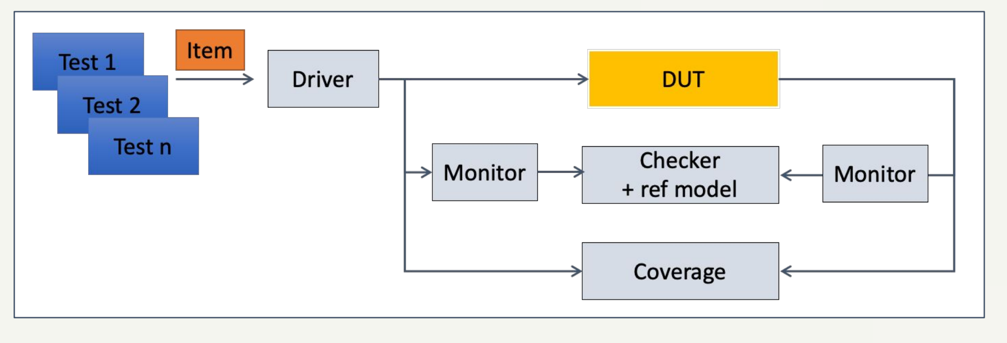
Verification Environment

Slide 5
Verification Environment Verification components
The DUT (Device Under Test) is a Frame Aligner module that identifies and aligns incoming data frames based on a specific header pattern. It uses a finite state machine (FSM) to detect valid headers (LSB and MSB) and aligns the data by counting the positions of valid and non-aligned frames. If three consecutive valid frames are detected, the module sets the frame_detect signal high, while 48 continuous invalid frames reset alignment.
The driver for the Frame Aligner module is responsible for providing a continuous stream of data (rx_data) to the DUT, simulating the incoming data frames. It sends data bytes sequentially, including specific header patterns (0xAA and 0x55 for LSB, followed by expected MSB values).

Slide 6
Verification Environment Verification components
Monitors
The monitors observes the input signals fed into the DUT as well as the output signals.
Scoreboard
The scoreboard checks the correctness of the result by comparing actual
outputs frame_detect, fr_byte_position with the expected outputs for each
frame, ensuring that the DUT behaves intended under different input conditions.
It maintains a reference model that simulates the correct behavior of the Frame
aligner .
The scoreboard verifies that the outputs match the expected results for each test
case, raising alerts if there is any mismatch.

Slide 7
Verification Environment Verification components
coverage
The coverage component tracks the functional coverage metrics during simulation to ensure all aspects of the Frame Aligner's functionality are thoroughly exercised.
Functional coverage includes checking that the Frame Aligner correctly detects the header patterns (0xAFAA or 0xBA55) and accurately transitions between alignment states. Coverage will also verify conditions such as resetting alignment when four consecutive frames do not contain the expected header. Coverage data is collected through dedicated cover groups and cover points that log the occurrence of each header pattern, the detection of three consecutive frames with valid headers, and scenarios where 48 consecutive bytes lack a header. This data provides insight into the robustness of the Frame Aligner and highlights any untested scenarios.

Slide 8
Features to be Verified
Frame Detection and Alignment
Detection of specific header patterns (0xAFAA or 0xBA55) in the incoming data stream.
Alignment establishment upon detecting three consecutive frames with valid headers.
Misalignment Handling
Detection of misalignment when four consecutive frames lack the valid header.
Correct flagging of frame_detect signal based on valid header presence.
Byte Counter Functionality
Monitoring of na_byte_counter to ensure correct counting of consecutive bytes without
a valid header.
Verification that frame_detect goes low after 48 consecutive bytes without a valid header.

Slide 9
Test Plan
Header Detection
Three consecutive frames with valid headers (0xAFAA or 0xBA55): verify alignment. Frame_detect is up to 1
Mixed valid and invalid headers: alignment only on three consecutive valid headers.
No valid headers: confirm no alignment.
Frame_detect
1
Head 0
Head 1
0
8'haa
8'haf
Pl[0]
Pl[1]
Pl[2]
Pl[3]
Pl[4]
Pl[5]
Pl[6]
Pl[7]
Pl[8]
Pl[9]
Head 0
Head 1
8'h55
8’hba
Pl[0]
Pl[1]
Pl[2]
Pl[3]
Pl[4]
Pl[5]
Pl[6]
Pl[7]
Pl[8]
Pl[9]
Head 0
Head 1
8'haa
8'haf
Pl[0]
Pl[1]
Pl[2]
Pl[3]
Pl[4]
Pl[5]
Pl[6]
Pl[7]
Pl[8]
Pl[9]

Slide 10
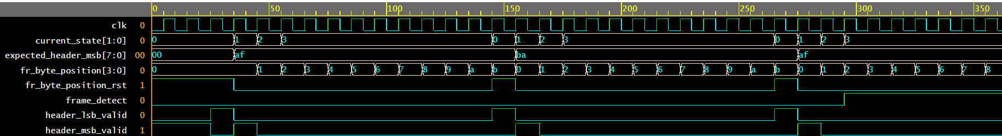






Header Detection

Slide 11
Misalignment Detection
Misalignment Detection
Four consecutive frames without valid headers: verify misalignment.
Alternating valid/invalid headers: misalignment only after four consecutive invalid frames.
Byte Counter
No valid headers for 48 bytes: frame_detect goes low.
Valid headers periodically: na_byte_counter resets with each valid header.

Slide 12
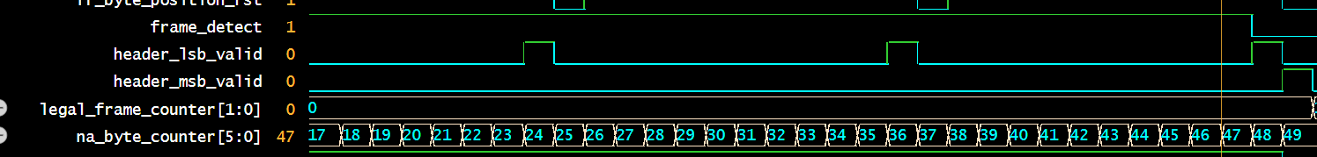
Misalignment Detection

Slide 13
List of Tests
Test # | Feature | Test Description | Expected Result
1 | Header Detection | Three consecutive frames with valid headers (0xAFAA or 0xBA55) | Alignment is detected frame_detect 1=
2 | Header Detection | Mixed valid and invalid headers | Alignment only on three consecutive valid headers
3 | Header Detection | Stream with no valid headers | No alignment is detected
4 | Misalignment Detection | Four consecutive frames without valid headers | Misalignment is flagged frame_detect = 0
5 | Misalignment Detection | Alternating valid and invalid headers | Misalignment only flagged after four consecutive invalid frames
6 | Edge case | 3 consecutive frames with valid header but last payload of the 3rd frame is invalid | frame_detect does not change.
7 | Edge case 2 | Frame detect at zero ,47 consecutive frames with invalid headers. | Frame detecet don’t change, only at 48 bytes
8 | Reset functionality | Test system response after reset signal is applied | All reg is reset.
9 | Header detection | Cross between (0xAF & 0x55) and (0xAA 0xBA) | Not valid header

Slide 14
Coverage plan
Header Coverage:
Ensured that all possible header patterns were evaluated during the simulation.
Byte Position Coverage:
Monitored the byte positions within frames to ensure that all positions from 0 to 11 were exercised during simulation.
Frame Detection Coverage:
Tracked when the frame_detect signal was asserted (indicating alignment) and when it was deasserted (indicating no alignment).
Functional Coverage
Header Detection
Cover detection of both valid headers (0xAFAA and 0xBA55) in three consecutive frames.
Include scenarios with varying numbers of valid headers (one, two, and three consecutive headers).
Cover streams with mixed valid and invalid headers.

Slide 15
Coverage plan
Misalignment Detection
Cover cases with four consecutive frames missing a valid header.
Cover transitions between alignment and misalignment based on valid and invalid headers.
Byte Counter
Cover scenarios where na_byte_counter reaches 48 consecutive bytes without a valid header,
resulting in frame_detect going low.
Include cases where valid headers appear intermittently, resetting the counter.

Slide 16
Coverage metrics
Functional goals :- full coverage for all test plan .
Code coverage :-
frame_detect coverage :100% .
header Coverage : 100%.
Byte postion Coverage:100%.

Slide 17
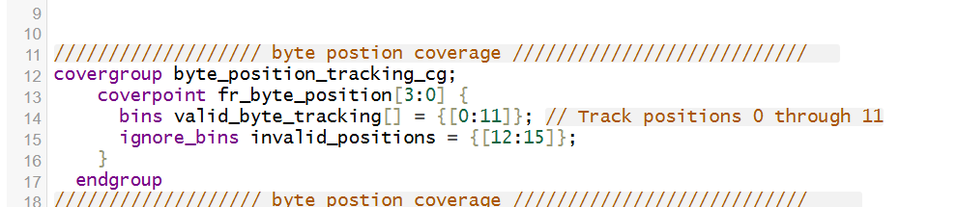
Byte position coverage
Description : ensure coverage of all byte positions from 0 to 11.

Slide 18
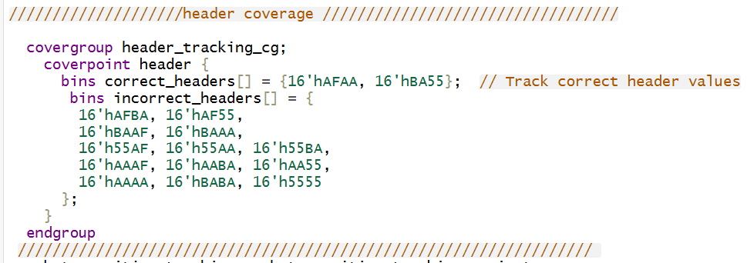
header Coverage
Description : ensure that all header edge case values have been checked

Slide 19
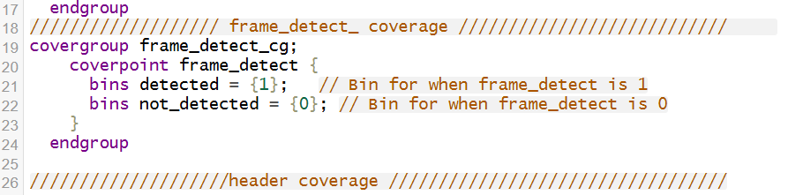
frame_detect
Description : ensure coverage for all frame detect values .

Slide 20
Lists of Test
Test Number | Description | Feature | Expected Result | Coverage
1 | Verify byte position tracking from 0 to 11 | Byte Position Tracking | Positions 0 through 11 are covered | byte_position_tracking_cg
2 | Verify frame detection when frame_detect is 1 | Frame Detection | frame_detect should be 1 | frame_detect_cg
3 | Verify frame detection when frame_detect is 0 | Frame Detection | frame_detect should be 0 | frame_detect_cg
4 | Verify correct header pattern detection | Header Tracking | Correct headers: 0xAFAA, 0xBA55 | header_tracking_cg
5 | Verify uncorrect header pattern detection | Header Tracking | Incorrect headers should be detected | header_tracking_cg

Slide 21
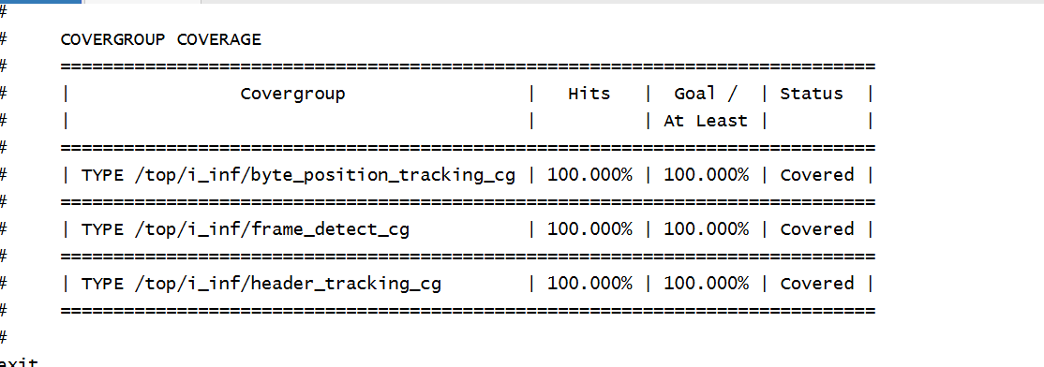
Results

Slide 22
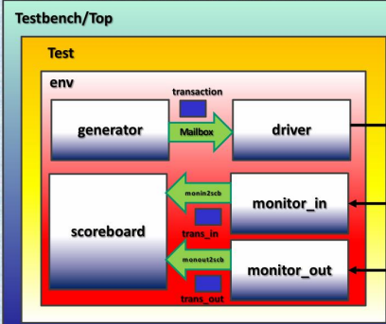
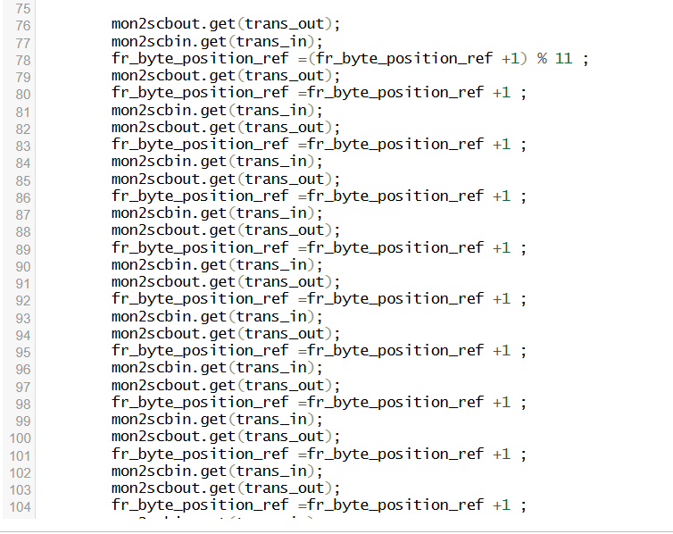
Bugs I faced
I encountered a bug where trans_out from the monitor_out was always zero.This issue arose because, in the scoreboard, I was only receiving trans_in from monitor_in,
which led to a synchronization conflict affecting trans_out. I fixed that by adding after every : mon2scbin.get(trans_in);
mon2scbout.get(trans_out);

Slide 23
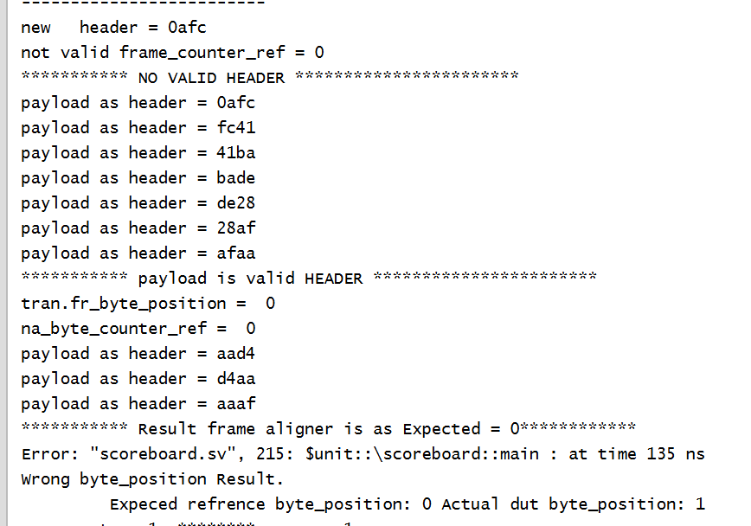
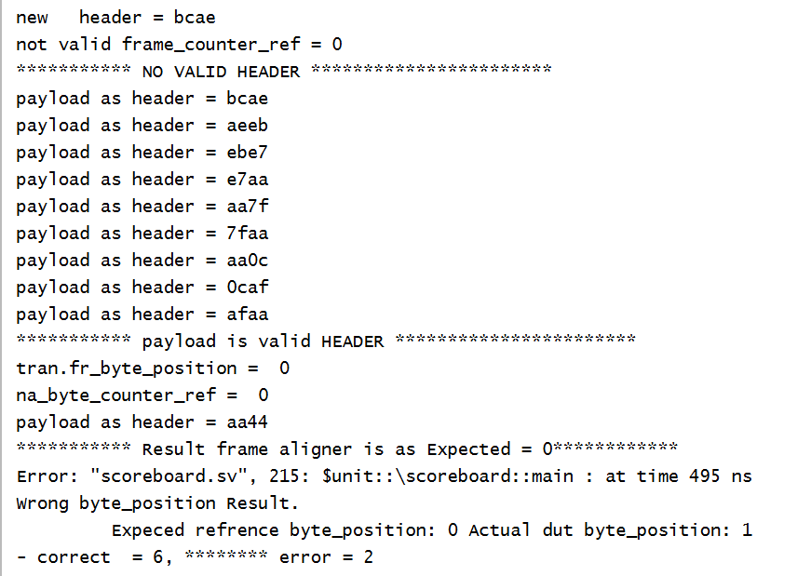


Bug at the spec
In the spec , there is no explanation for what the design should do if we got a two bytes in the payload that make a valid header (in a frame with no valid header ) , when we got a header in the payload we expect that the na byte counter will reset , but we don’t have information about the byte position, because of that I got errors , only thing we expect is that the byte position will be at zero .

Slide 24
